Slide 1
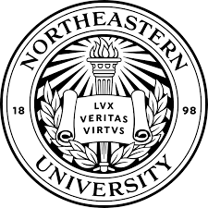
Machine Learning for Quantum Noise Reduction
- Karan Kendre, MSCS

Slide 2
Introduction
Motivation:
Quantum computing is an emerging revolutionary field and will be the next era of computing as we reach the limits of Moore’s law. we can’t have better performance without tapping in the realm of quantum. QC has potential to drastically outperform classical computing in fields like cryptography, pharmaceuticals, optimization problems, and complex simulations. However, quantum systems are extremely sensitive and vulnerable to noise, which can significantly degrade computational accuracy.
Business:
Quantum noise induces errors that limit the practical scalability and reliability of quantum computers. For companies heavily investing in quantum technology, such
as tech giants like IBM, Google, and Amazon, pharmaceutical firms, financial institutions, and national research institutes, preventing quantum noise is critical. Effective quantum noise reduction can accelerate the development of practical quantum computing applications and make them more reliable. However, noise-generated errors are significant problems, complicating practical use and uptake. Effectively reducing or removing quantum noise is thus key to businesses that want to employ quantum computing for tangible, real-world use, competitive edge, and strategic technological influence.
Importance (Broader context)
Quantum noise analysis and suppression by new methods such as machine learning directly contribute to the acceleration of the progress of quantum computing from theoretical potential to practical reality. With the use of advanced machine learning software such as convolutional neural networks (CNN), we can actively reconstruct noisy quantum state measurements, effectively correcting errors. Not only does this enhance computational stability but also opens up feasible commercial applications for quantum computing. Firms can then proceed to use quantum computing securely to crack hitherto insurmountable challenges and revolutionize sectors like cybersecurity, logistics optimization, pharmaceutical discovery, and finance modeling.

Slide 3
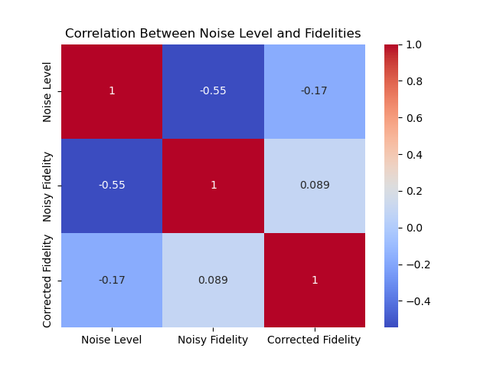
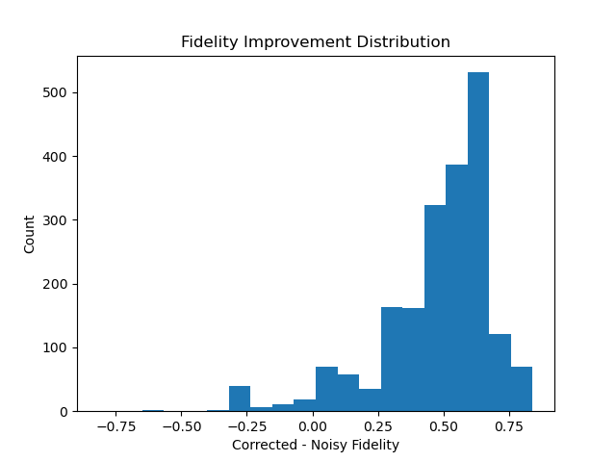
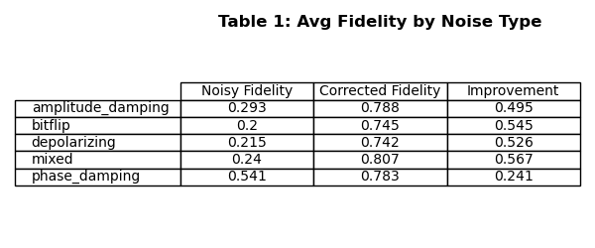
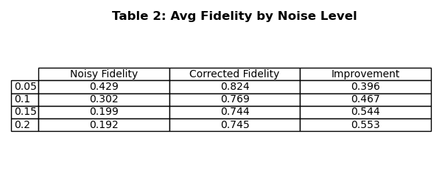
Data Analysis and Feature Discovery
Original Analysis
Computed fidelity for 10K noisy-clean pairs, analyzed improvement across noise types & levels. Identified top-5 and bottom-5 samples by fidelity gain
Methods Used
1. Grouped averages with pandas. 2. Made correlation matrix (Pearson) → -0.55 (noise level vs fidelity).
3. Histogram of fidelity improvements Sample sorting to detect edge case behaviour.
Model work best for mixed and bitflip noise and struggled for
Phase damping noise.
Higher noise levels yielded better learning margins.

Slide 4
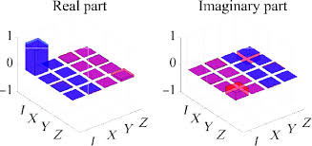
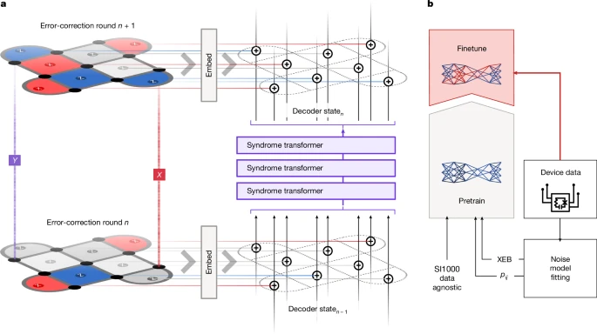
Related Inspiring Work
Efficient Quantum State Tomography with CNNs [link: npj Quantum Information, 2022] - Used Convolutional Neural Networks (CNNs) to reconstruct quantum states from tomographic data. - Outperformed traditional convex optimization methods in speed and accuracy. - Tackled the scalability issue in high-dimensional quantum tomography. Inspiration: - We also use CNNs though not for tomography but for denoising density matrices. - Their results corroborate that CNNs can learn quantum state structures effectively.
Fig.1 Tomographic data of qubit.
AlphaQubit: Neural Decoder for Surface Codes [link: nature, 2024] - Used a Transformer-based model to decode quantum errors from real hardware (Google Sycamore). - Demonstrated superior generalization across code layouts and noise profiles. - First practical deep learning application in real QEC hardware. Inspiration: - Validates the idea that deep models can outperform traditional decoders. - Though not doing decoding, we are solving a similar problem that is to removing quantum noise using learned patterns.
Fig.2 Error correction and training of AlphaQubit.

Slide 5
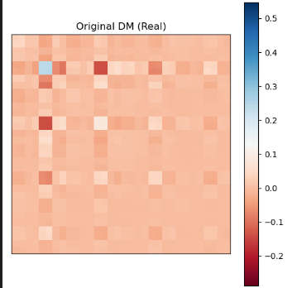
Data Processing and Training Pipeline
Simulation and Preparation:
Randomly simulated complex quantum circuit with 5 qubits with depth 6-9.
Sampled diverse gate combinations (Hadamard, Rx, Ry, CZ, SWAP etc.)
Applied 5 types of realistic noises such as , Depolarizing, Amplitude damping, Phase damping, Bitflip and mixed (as per the suggestions).
All these noises were random and were paired with its clean counterpart.
Lastly, we extracted density matrix for both clean and noisy circuits and stored the output as 2^n x 2^n complex matrices.
Data Transformation for our model:
Dataset was split into 3 parts Train (64%), Val (16%) and Test (20%).
Separated the real and imaginary component of the complex matrix and converted each matrix into a 2-channel format X = [Real(noisy), Imaginary(noisy)] Y = [Real(clean), Imaginary(clean)].
Final input for our model was of shape (32, 32, 2) for 5 qubits. (This input allows the model to learn both magnitude and phase patterns in the density matrix. while mimicking image data)
Visualization:
Figure 3 shows the density matrix for the real component of the complex matrix. Ex: element (4,9) represents the real part of the amplitude/coherence between: ∣00100⟩ and ∣01001⟩
The horizontal bar ranging from -0.2 to 0.5 is a color scale that maps numerical values (from the real part of the density matrix) to specific colors on the heatmap.
Fig 3. Density matrix for Real component

Slide 6
Proposed Method and Learning Algorithm
Model Architecture: CNN (Convolutional Neural Network) - Input shape: (32, 32, 2) real and imaginary parts of noisy 5-qubit density matrix.
Six convolutional blocks with max pooling for compression, up-sampling for reconstruction.
Final layer output (32, 32, 2) real and imaginary parts of predicted clean 5-qubit density matrix.
Loss Function (custom): Loss = MSE + 0.5 x (1 – Fidelity) (combines structural difference (MSE) with quantum similarity (Fidelity)
Optimizer: Adam, with ReduceLRonPlateau and EarlyStopping callbacks.
Training time: 100 epochs on 10,000 simulated circuits.
Why Does it work? 1. CNNs are excellent at capturing spatial patterns, perfect for detecting structured quantum noise patterns in density matrices.
2. Inspired by autoencoder-like structure, where the model compresses and reconstructs input.
PROS | CONS
Learns nonlinear noise patterns across quantum states. | Fixed input size: doesn’t scale directly to >5 qubits.
Generalizes to multiple noise types & levels. | Needs a large simulated dataset.
Fidelity-aware training leads to quantum-meaningful outputs. | Struggles slightly with high-noise cases like depolarizing noise.

Slide 7
Our Learnings
Model Performance
Average Fidelity Improvement: Across all test samples, fidelity improved from ~0.27 (noisy) to ~0.77 (corrected).
Histogram shows most samples improved by +0.4 to +0.75 → Model consistently denoised even highly distorted quantum states.
Performance by Noise Type Best: Mixed (+0.567) and Bitflip (+0.545).
Performance by Noise Type Challenging: Phase Damping (+0.241) — already had high fidelity, less room to improve.
Performance by Noise Level: Improvement increased as noise got worse: From +0.396 at 0.05 → +0.553 at 0.20 Model adapted well to more corrupt inputs
Why the Model Performed This Way
CNNs capture local and global patterns in the matrix — ideal for structured distortions like bitflip or amplitude damping
Phase damping already preserves diagonal fidelity → less visible gain
Negative correlation (-0.55) between noise level and noisy fidelity confirms this pattern
What Motivated Our Final Solution
Initial shallow CNNs failed on high noise (fidelity stayed <0.65)
We added: - Deeper encoder-decoder layers. - Dropout to avoid overfitting. - Fidelity-aware loss function to guide quantum recovery.
These changes led to ~20% increase in fidelity gains

Slide 8
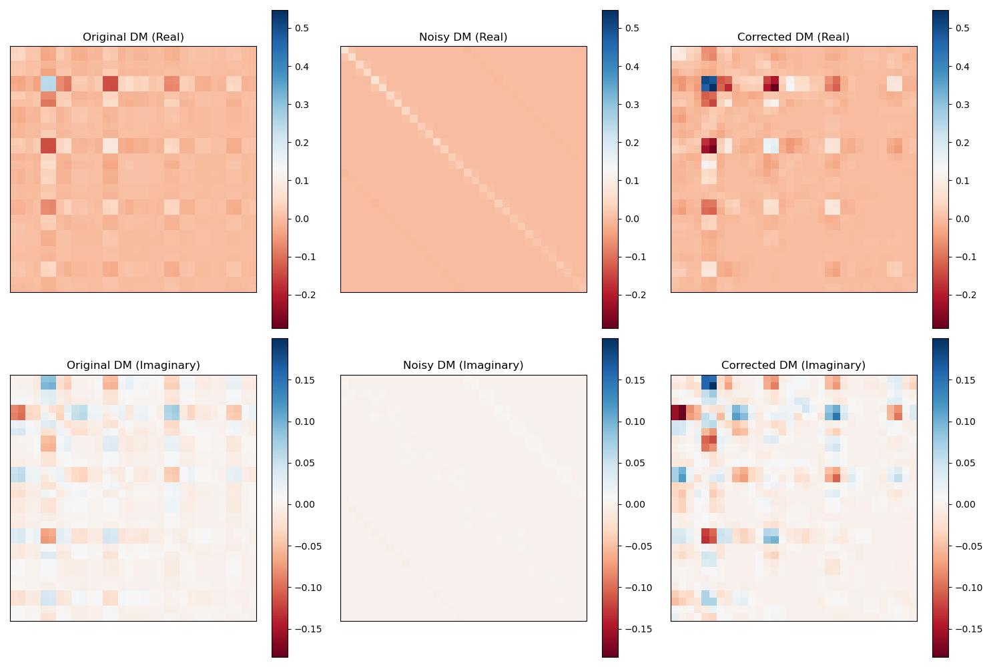
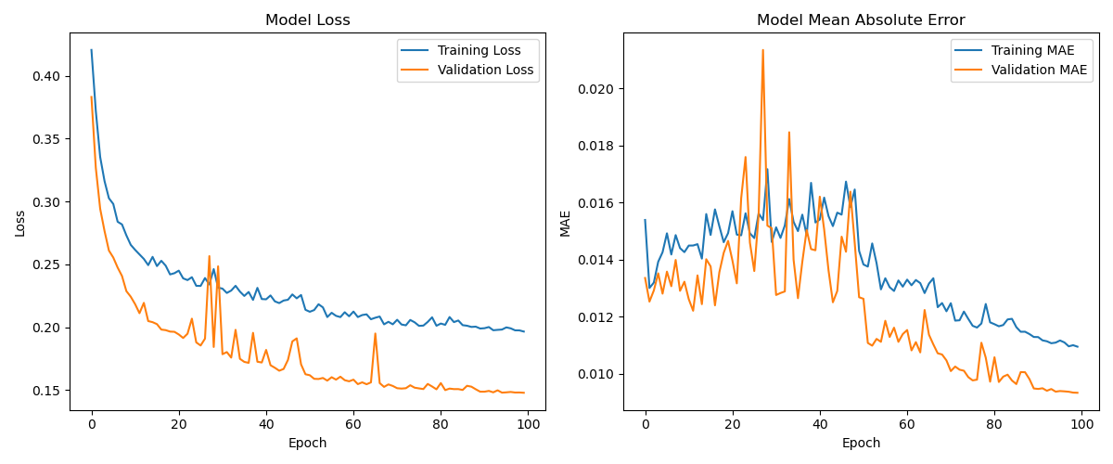
Results
Fig. 4 Corrected DM output of our model.
Fig. 5 Model Loss and MAE while training.
Takeaway: Our model successfully learned to denoise quantum states across diverse noise profiles with significant fidelity recovery, especially in lower-structure noise types like bitflip and mixed noise. These results validate the effectiveness of CNNs on complex-valued quantum data.

